Slide 1
C - Decision Making Control Statement and Branching
Check every condition

Slide 2
C - Decision Making
Decision making structures require that the programmer specify one or more conditions to be evaluated or tested by the program, along with a statement or statements to be executed if the condition is determined to be true, and optionally, other statements to be executed if the condition is determined to be false.

Slide 3
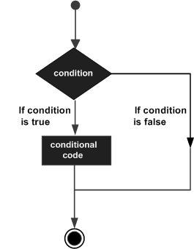
C - Decision Making cont.
Following is the general form of a typical decision making structure found in most of the programming languages:
C programming language assumes any non-zero and non-null values as true, and if it is either zero or null, then it is assumed as false value.

Slide 4
Types of control statements
C language provides following types of decision making statements. Click the following links to check their detail.
Statement | Description
1. if statement | An if statement consists of a Boolean expression followed by one or more statements.
2. if...else statement | An if statement can be followed by an optional else statement, which executes when the Boolean expression is false.
3. nested if statements | You can use one if or else if statement inside another if or else if statement(s).
4. if...else if..else statement | An if statement can be followed by an optional else if...else statement, which is very useful to test various conditions using single if...else if statement.
5. switch case-statement | A switch statement allows a variable to be tested for equality against a list of values.
6. nested switch statements | You can use one switch statement inside another switch statement(s).
7. Ternary operator ? : | ?: can be used to replace if...else statements
8. goto statement | The goto statement transfers control to a label.

Slide 5

1. If Statement
An if statement consists of a Boolean expression followed by one or more statements.
Syntax:
If the expression evaluates to true, then the block of code inside the if statement will be executed.
If expression evaluates to false, then the first set of code after the end of the if statement will be executed.
C language assumes any non-zero and non-null values as true and if it is either zero or null, then it is assumed as false value.

Slide 6
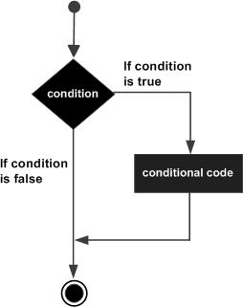
If Flow Diagram

Slide 7
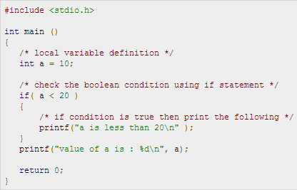
Code Example

Slide 8
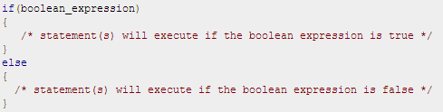
2. if...else statement
An if statement can be followed by an optional else statement, which executes when the Boolean expression is false.
Syntax:
If the Boolean expression evaluates to true, then the if block of code will be executed, otherwise else block of code will be executed.

Slide 9
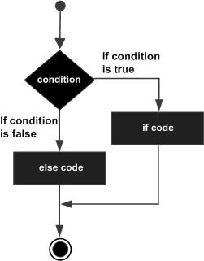
If…else Flow Diagram

Slide 10
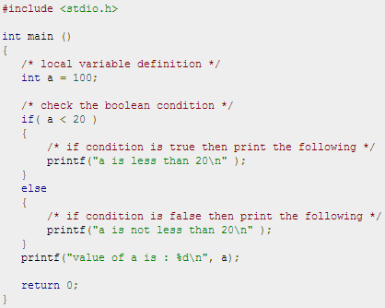
Code Example : If else

Slide 11
3. The if...else if...else Statement
An if statement can be followed by an optional else if...else statement, which is very useful to test various conditions using single if...else if statement.
When using if , else if , else statements there are few points to keep in mind:
An if can have zero or one else's and it must come after any else if's.
An if can have zero to many else if's and they must come before the else.
Once an else if succeeds, none of the remaining else if's or else's will be tested.

Slide 12
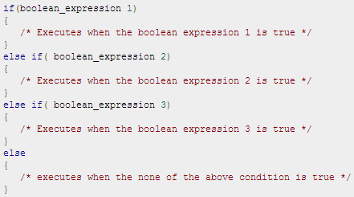
The if...else if...else Syntax.

Slide 13
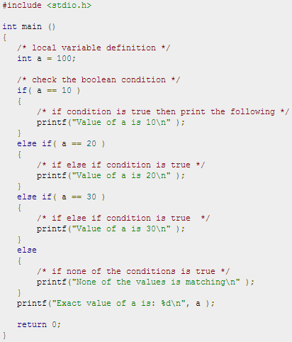
Code example: if...else if...else

Slide 14
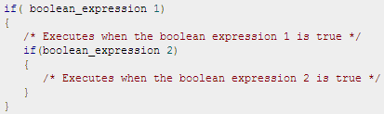
4. C - nested if statements
It is always legal in C to nest if-else statements, which means you can use one if or else if statement inside another if or else if statement(s).
Syntax:
You can nest else if...else in the similar way as you have nested if statement.

Slide 15
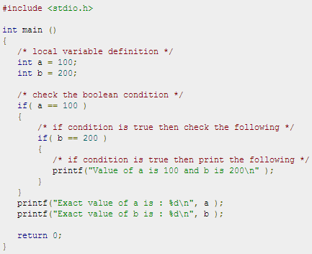

Code Example: nest else if...else

Slide 16
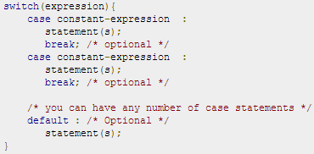
5. C - switch statement
A switch statement allows a variable to be tested for equality against a list of values.
Each value is called a case, and the variable being switched on is checked for each switch case.
Syntax:

Slide 17
rules apply to a switch statement:
The expression used in a switch statement must have an integral or enumerated type.
You can have any number of case statements within a switch. Each case is followed by the value to be compared to and a colon.
The constant-expression for a case must be the same data type as the variable in the switch, and it must be a constant or a literal.
When the variable being switched on is equal to a case, the statements following that case will execute until a break statement is reached.
When a break statement is reached, the switch terminates, and the flow of control jumps to the next line following the switch statement.
Not every case needs to contain a break. If no break appears, the flow of control will fall through to subsequent cases until a break is reached.
A switch statement can have an optional default case, which must appear at the end of the switch.
The default case can be used for performing a task when none of the cases is true. No break is needed in the default case.

Slide 18
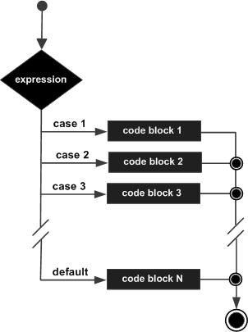
Switch-Case Flow Diagram

Slide 19
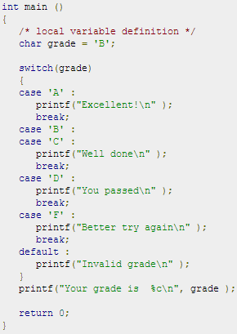
Code Example: Switch-Case

Slide 20
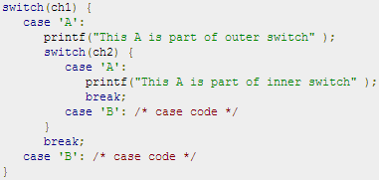
6. C - nested switch statements
It is possible to have a switch as part of the statement sequence of an outer switch. Even if the case constants of the inner and outer switch contain common values, no conflicts will arise.
Syntax:

Slide 21
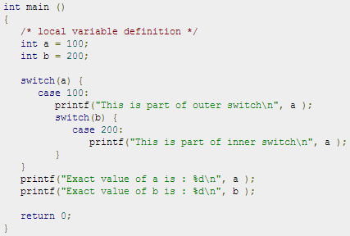

Code Example: Nested Switch-Case

Slide 22
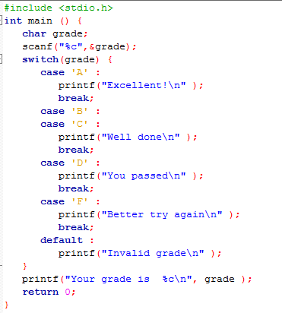
Switch Case to if else conversion

Slide 23
7. The ? : Operator
We have covered conditional operator ? : previously which can be used to replace if...else statements. It has the following general form:
Where Exp1, Exp2, and Exp3 are expressions. Notice the use and placement of the colon.
The ?: is called a ternary operator because it requires three operands.
The value of a ? expression is determined like this:
Exp1 is evaluated. If it is true, then Exp2 is evaluated and becomes the value of the entire ? expression.
If Exp1 is false, then Exp3 is evaluated and its value becomes the value of the expression.

Slide 24


The ? : Operator cont.
?: operator can be used to replace if-else statements, which have the following form:
For example, consider the following code:
Above code can be rewritten like this:
Here, x is assigned the value of 30 if y is less than 10 and 40 if it is not. You can the try following example:

Slide 25

8. The goto statement
A goto statement in C language provides an unconditional jump from the goto to a labeled statement in the same function.
The given label must reside in the same function.
Syntax:
Here label can be any plain text except C keyword and it can be set anywhere in the C program above or below to goto statement.
NOTE: Use of goto statement is highly discouraged in any programming language because it makes difficult to trace the control flow of a program, making the program hard to understand and hard to modify. Any program that uses a goto can be rewritten so that it doesn't need the goto.

Slide 26
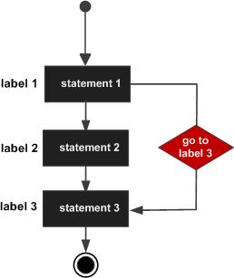
Goto statement Flow Diagram

Slide 27
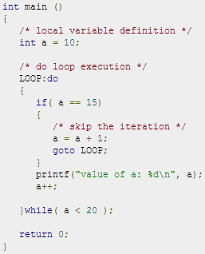
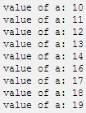
Code Example: goto statement
Output:

Slide 28
Class Work
Write a program that will teach digit of different methods. At first, the program will offer options of different methods. Then they let them learn the symbols.
Example:
Choose from the given methods to learn:
English digit.
Roman digit.
If they choose 1 then let them learn as below:
Press any digit from 0-9 : 1
1 spells as ‘One’.
On the other hand, if they choose 2 then let them learn as below:
Press any digit from 0-9 : 3
In Roman method ‘3’ represents as ‘III’

Slide 29
Thank You

